Slide 1
AIDS PROJECT Fake News Detection BY Dr. Figlu Mohanty
By 2110030300-VIRINCHI KOTHE
2110030324-NAVYA CHALASANI
2110030325-K.VAISHNAVI
2110030315-V.AISHWARYA
2110030203-MANASRI REDDY

Slide 2
PROBLEM STATEMENT:
Fake news is false or misleading information presented as news. Fake news often has the aim of damaging the reputation of a person or entity, or making money through advertising revenue.
The prevalence of fake news has increased with the recent rise of social media, especially the Facebook news feed, and this misinformation is gradually seeping into the mainstream media.

Slide 3
OBJECTIVE:
To build a model to accurately classify a piece of news as REAL or FAKE.
This advanced python project of detecting fake news deals with fake and real news.

Slide 4
DATA SET REFERENCE:
https://www.kaggle.com/datasets/clmentbisaillon/fake-and-real-news-dataset

Slide 5




SOFTWARE REQUIREMENTS:
Jupyter Notebook.
PyCharm IDE.
VS Code.
Data Set from Kaggle.

Slide 6
FUTURE WORK:
We will work on the code , training a model using the data set.

Slide 7
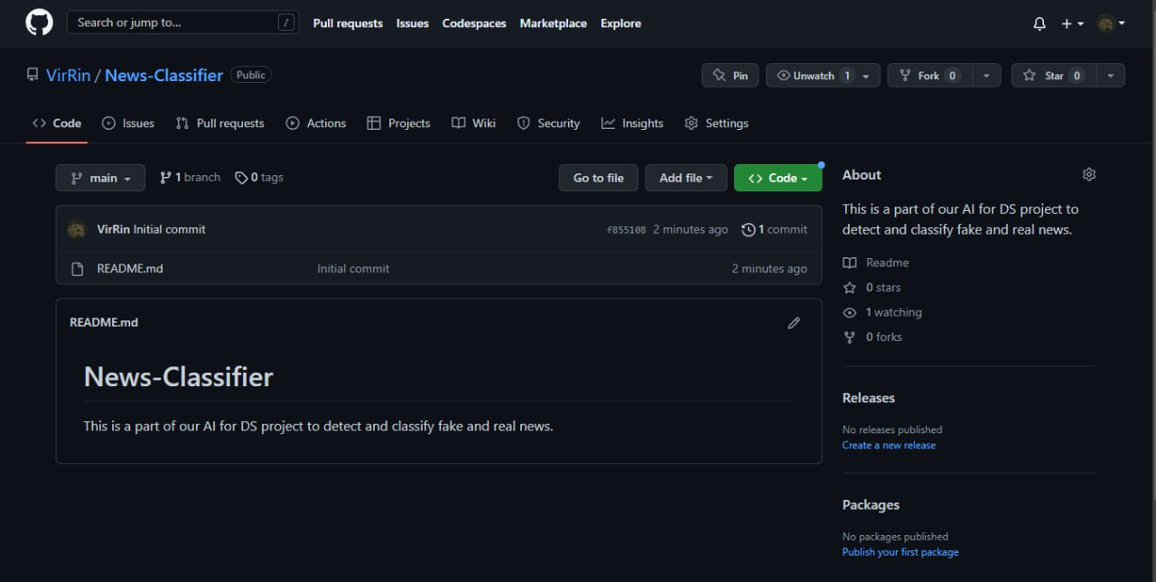
GITHUB REPOSITORY:

Slide 8


